Slide 1
Static and Dynamic Modelling

Slide 2
Static and Dynamic Modelling
Please go through the Case Study (SAD Electronic Voting Case Study.pdf)
Refer to the requirements that you created
Refer to the System Context and Architecture Overview that you created
We will create static (structural) and dynamic (behavioural) model for this.
Notes:
test

Slide 3
Static and Dynamic Modelling : Recapitulation
Define system boundary
Create structure of the solution
Refine the structure to implement the solution
  How can the conceptual elements be subdivided into subsystems?
  How do the subsystems look like?
  How do the subsystems interact with each other functionally?
Notes:
test

Slide 4

Static and Dynamic Modelling : Structural/Static Modeling - Process
Identify Subsystems
  identity, behaviour
  relationships
Within each Subsystem
  Identify Classes
    methods, attributes, services to be exposed
    relationships
  Identify Entities
    attributes
    relationships
  Identify Services to be exposed/consumed
As Appropriate
Notes:
test

Slide 5

Static and Dynamic Modelling : Behavioural (Dynamic) Modeling
We model behaviour at two levels
  End User
  Developer
    Intra Subsystem Level
    Inter Subsystem Level
    Object Level
Notes:
test

Slide 6
Static and Dynamic Modelling : Good Practices for Structuring
Highly cohesive
Loosely coupled
Well isolated
Of the right granularity
Layered according to their generality
Notes:
test

Slide 7
Cohesion, Coupling, Granularity examples

Slide 8
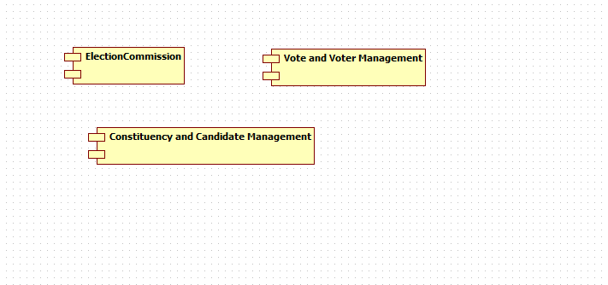
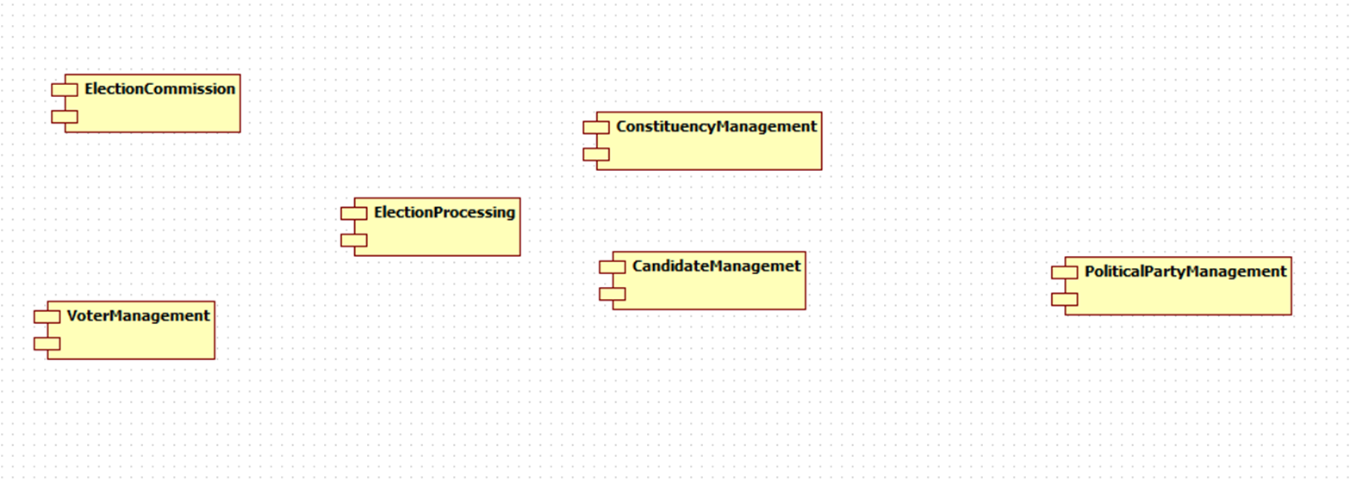
Static and Dynamic Modelling : Cohesion Example
Low cohesion
  Functionalities have no meaningful relationship to each other
  They are related in time only
  Are of the same general category that is selected externally
High cohesion
  Functionalities contribute to a few related business activities only
  They are likely to use the same input or output data
  They are likely to be used together
Notes:
test

Slide 9
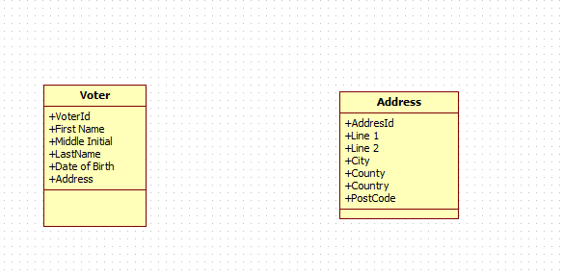
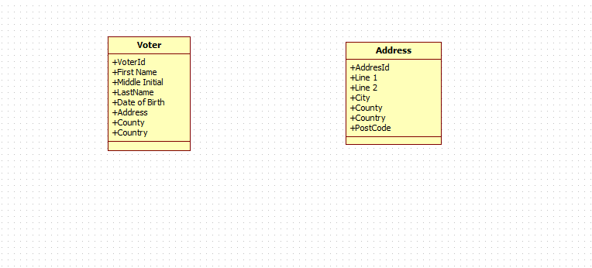
Static and Dynamic Modelling : Coupling Example
Strong coupling
  Subsystems refer to the same global data area
  One subsystem refers to the inside of another
  Data that is intended to control the internal subsystem logic is passed
Loose coupling
  No unnecessary inter-subsystem communication
  Communication is via fundamental data types
  If communication is via composite data, then it is self-describing, such as XML
Notes:
test

Slide 10
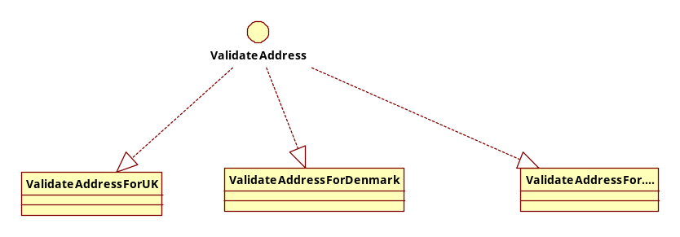
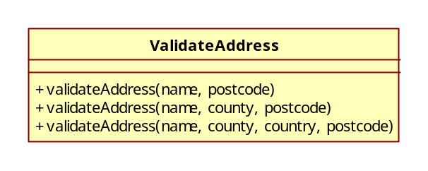
Static and Dynamic Modelling : Granularity Example
Coarse-Grain
  Set of cooperating elements assembled as a subsystem to deliver a solution to a business problem
Fine-Grain
  Software element called at run time with a clear interface and a separation between interface and implementation
Notes:
test

Slide 11
Sample walkthrough

Slide 12
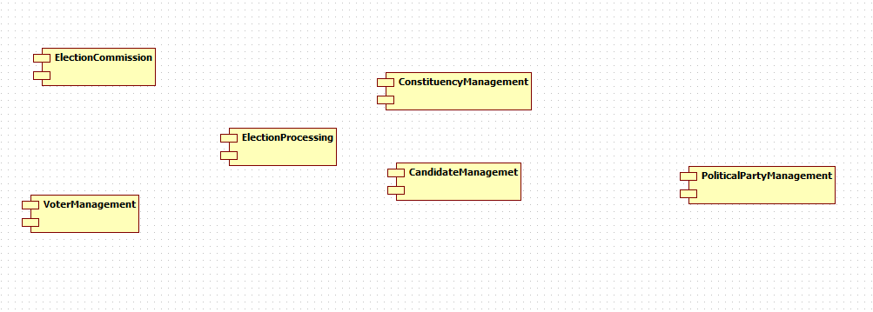
Static and Dynamic Modelling : Online Voting Example
Identify Subsystems
Notes:
test

Slide 13
Static and Dynamic Modelling : Online Voting Example
Lets take VoterManagement subsystem
  Here are some sample classes
Notes:
test

Slide 14
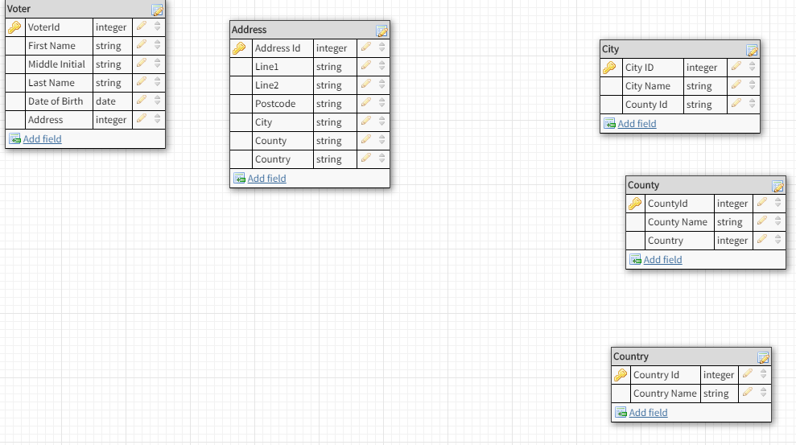
Static and Dynamic Modelling : Online Voting Example
Lets take VoterManagement subsystem
  Here are some sample entities
Notes:
test

Slide 15
Static and Dynamic Modelling : Online Voting Example
Lets take VoterManagement component
  We will use postcode validation service from https://getaddress.io/
Notes:
test

Slide 16
Static and Dynamic Modelling : Online Voting Example
For Components/Classes
  Dependency
  Generalization
  Realization
  Association
  Aggregation
For Database Entities
  Foreign Key
Notes:
test

Slide 17
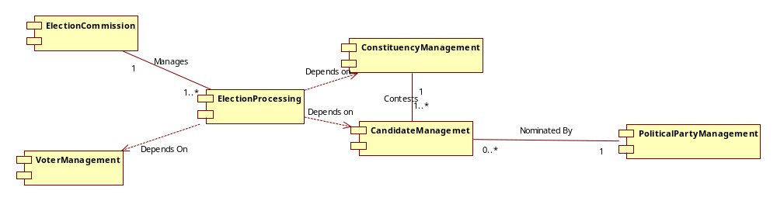

Static and Dynamic Modelling : Online Voting Example- Component Relationship Diagram
Notes:
test

Slide 18
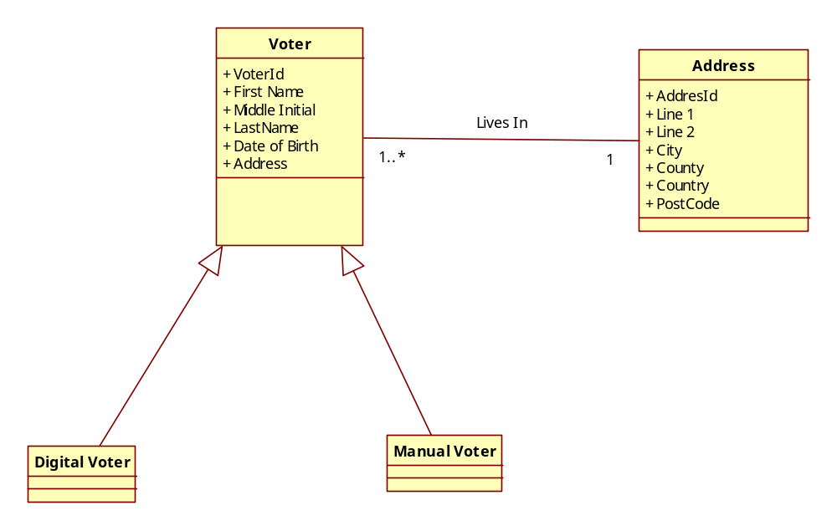
Static and Dynamic Modelling : Online Voting Example- Class Diagram
Notes:
test

Slide 19
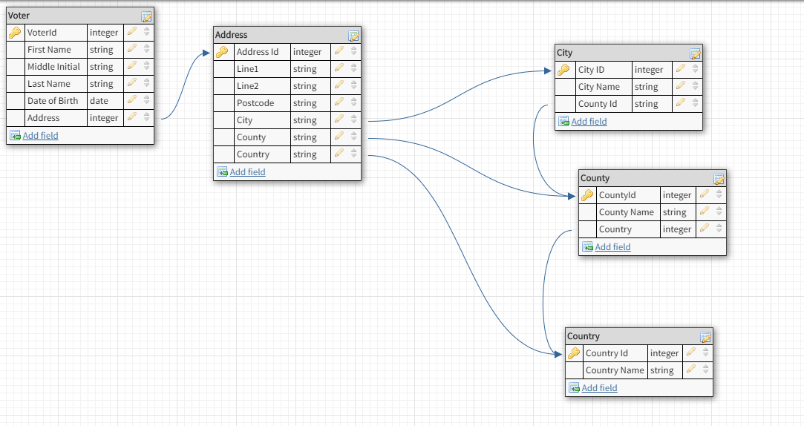
Static and Dynamic Modelling : Online Voting Example- Entity Relationship Diagram
Notes:
test

Slide 20
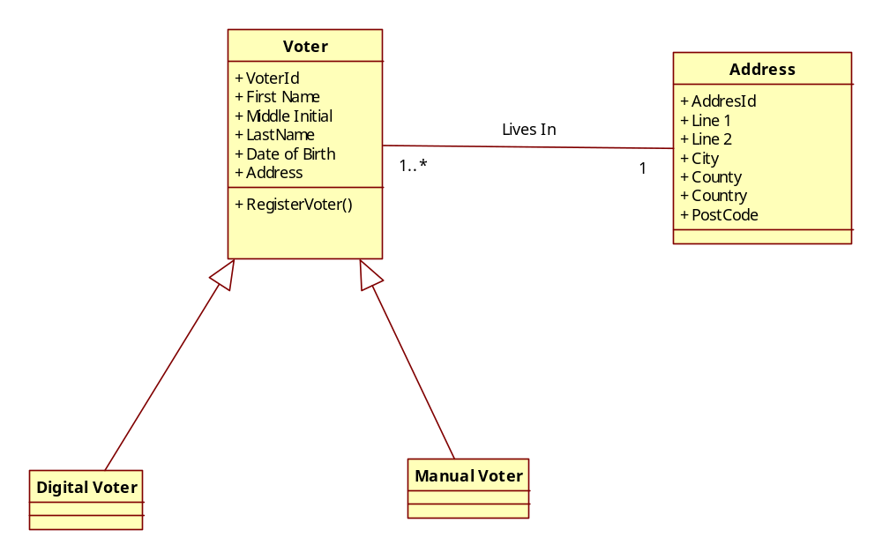
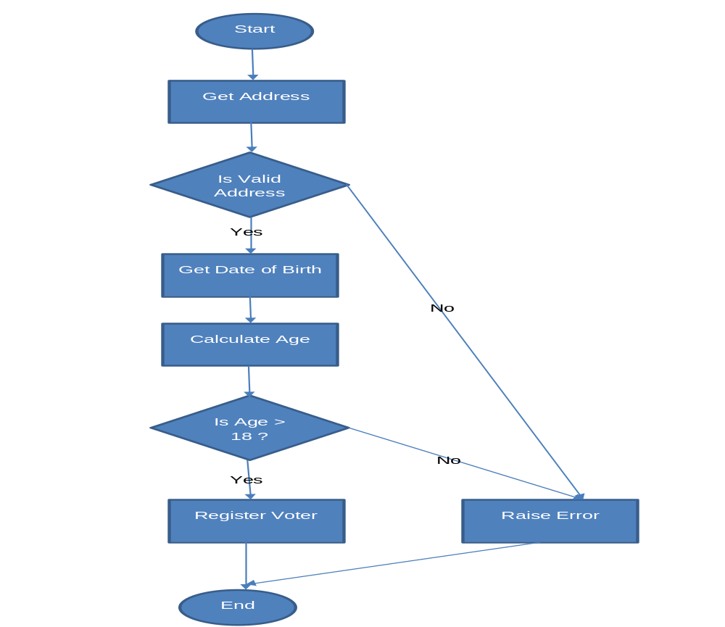
Static and Dynamic Modelling : Online Voting Example- Intra Subsystem Level- Register Voter
Notes:
test

Slide 21
Static and Dynamic Modelling : Online Voting Example- Inter Subsystem Level
Notes:
test

Slide 22
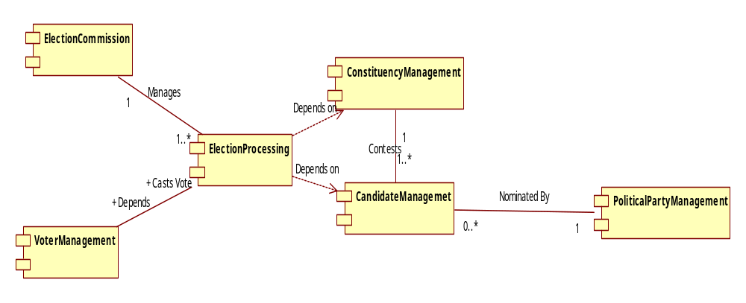
Static and Dynamic Modelling : Online Voting Example- Inter Subsystem Level
Notes:
test

Slide 23
Static and Dynamic Modelling : Online Voting Example- Inter Subsystem Level
Will see this sequence
Notes:
test

Slide 24


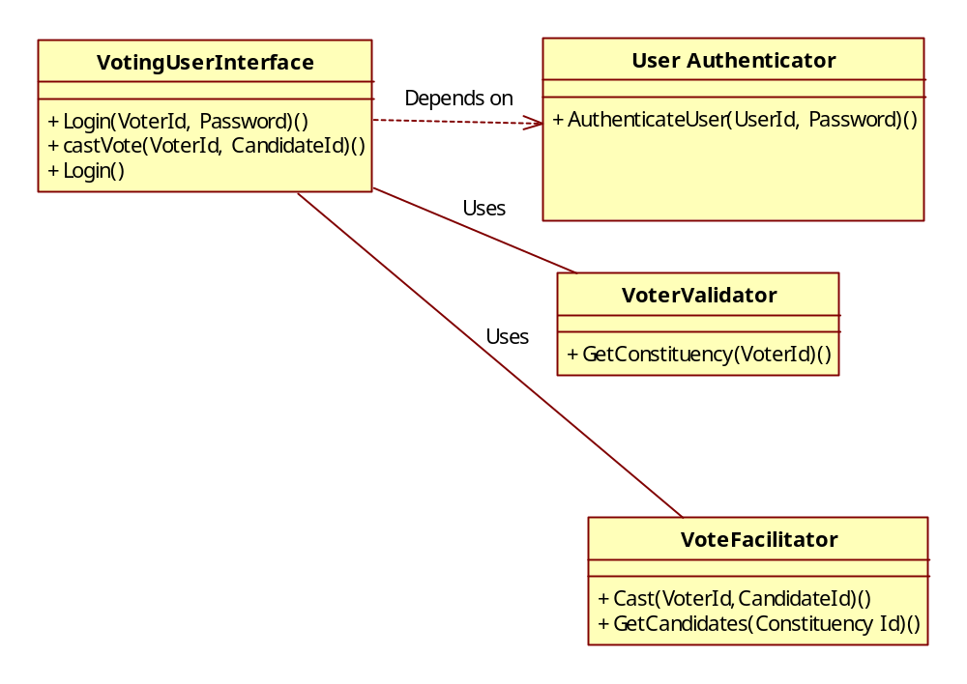
Design Tutorial : Behavioural Modeling - Inter Subsystem Level
Notes:
test

Slide 25
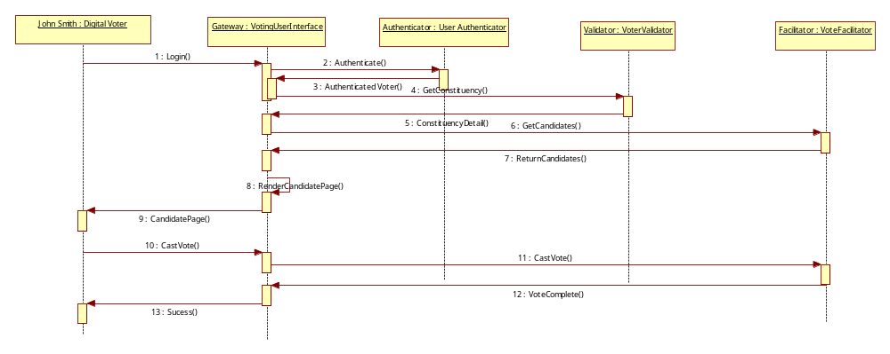
Static and Dynamic Modelling : Online Voting Example- Inter Subsystem Level
Notes:
test

